Slide 1






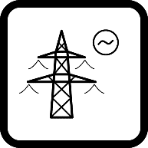
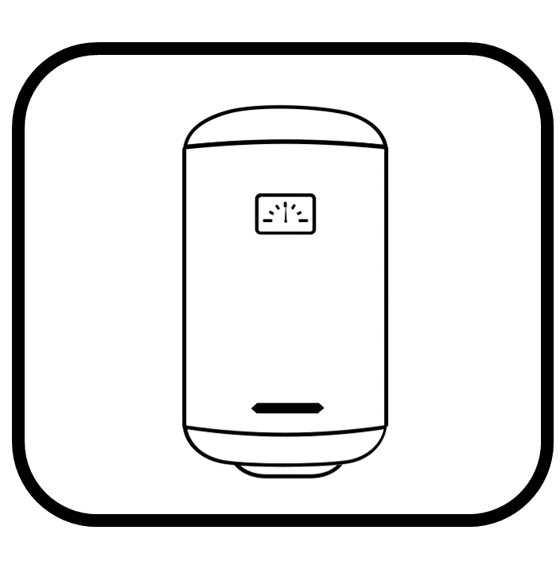


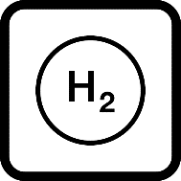



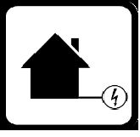
Biomass
PV
Wind onshore
Wind offshore
Hydro RoR
CHP
Thermal Storage
Electricity grid
Heat Bus
Heat Pump
Electricity Bus
Heat grid
Hot water demand
Heat demand
Battery
Hydrogen
ACAES
Electricity demand

